Slide 1

Mechanical Engineering Senior Design (ME490W) Team MAM8-23-B, Titan Seals Project 23, Gas Turbine Driveshaft Covers Project Management Plan October 9, 2023
Shane Arana, Alan Beal, Ignas Kasulaitis, Edward Muollo

Slide 2
Project Overview
Problem Statement:
Oil leaks from the driveshaft assembly that transfers the mechanical energy from the driver to the driven equipment is forcing unwanted shutdowns of industrial turbine engines and causing environmental damage.
Need:
Redesign of the driveshaft cover assembly to improve sealing effectiveness and reliability.
Sponsor Info:
Solar Turbines
Project Sponsor Manager: Gregor Robertson
Project Mentors: Jordan Fereira, Priscilla Ng
Notes:
Problem - Importance of reliability in our design
Need - Discuss 2 different objectives and explain how we are going to pursue both but our final design will only be one or the other.

Slide 3
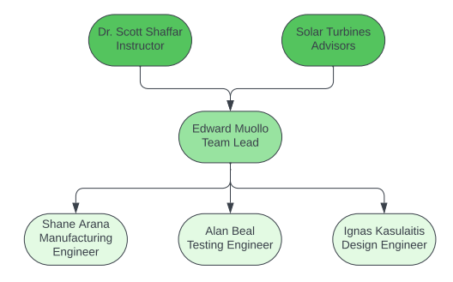
Team Organization Chart

Slide 4
Team SOW Table
Name | Role | Duties
Dr. Scott Shaffar | Instructor | Provides resources and guidance to help team effectively complete project deliverables. Monitors the teams progress.
Solar Turbines Team | Advisors/Sponsor | Communicates problem, need and project requirements. Shares subject matter expertise. Provides budget.
Edward Muollo | Team Lead | Manages scheduling, team roles and responsibilities. Maintains effective communication with Solar Turbines Team and Dr. Shaffar.
Shane Arana | Manufacturing Engineer | Material research, selection and procurement. Oversees budget.
Alan Beal | Testing Engineer | Fabrication and assembly of test rig. Documents test results and verifies hydrostatic test requirements are met.
Ignas Kasulaitis | Design Engineer | Design cataloging and vetting. Finalizing design documents including 3D models for prototypes and designs.

Slide 5
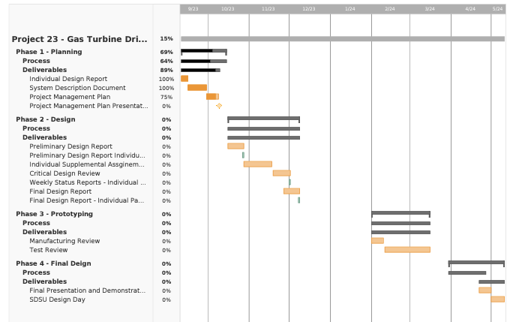
Schedule - IMS (Gantt Chart)

Slide 6
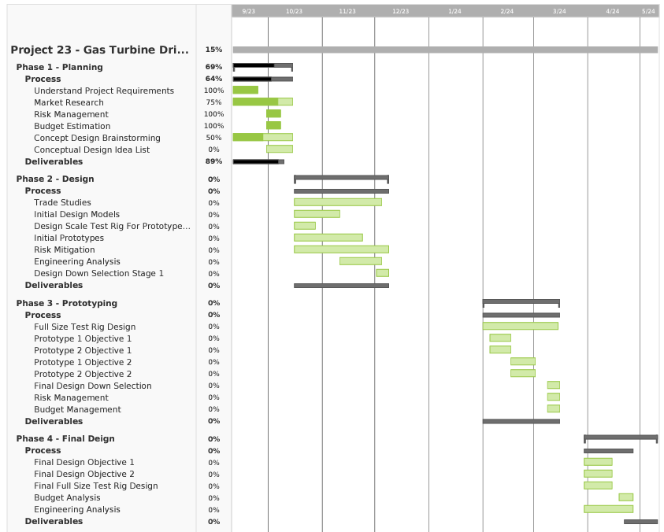
Schedule - IMS (continued)

Slide 7
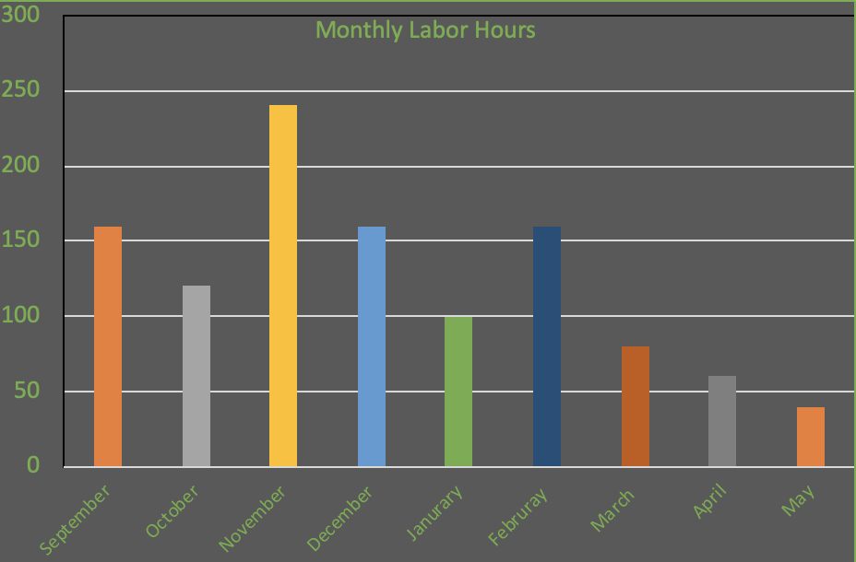
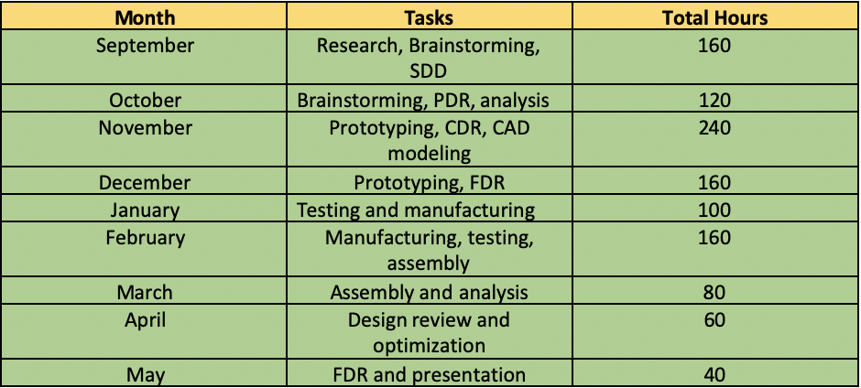
Budget - Labor Budget Estimate

Slide 8
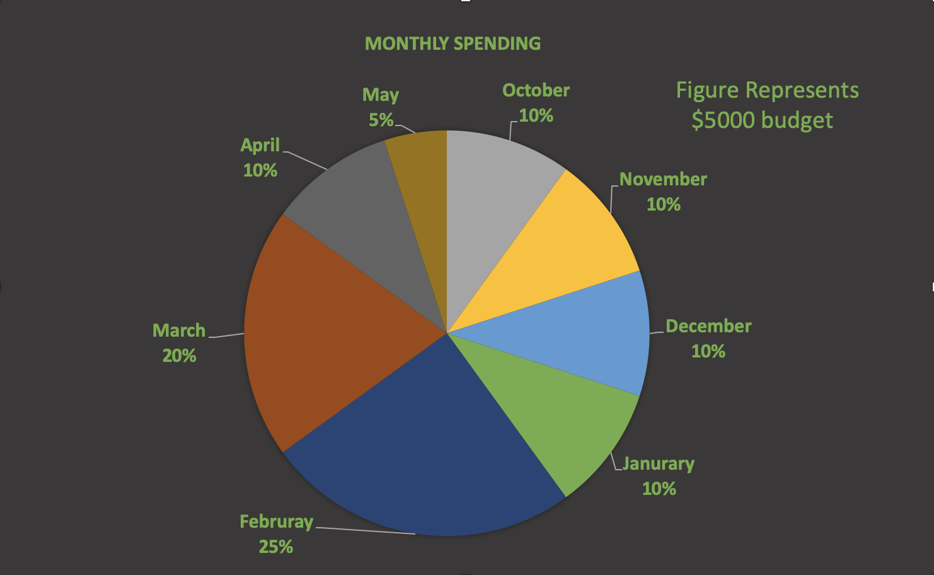
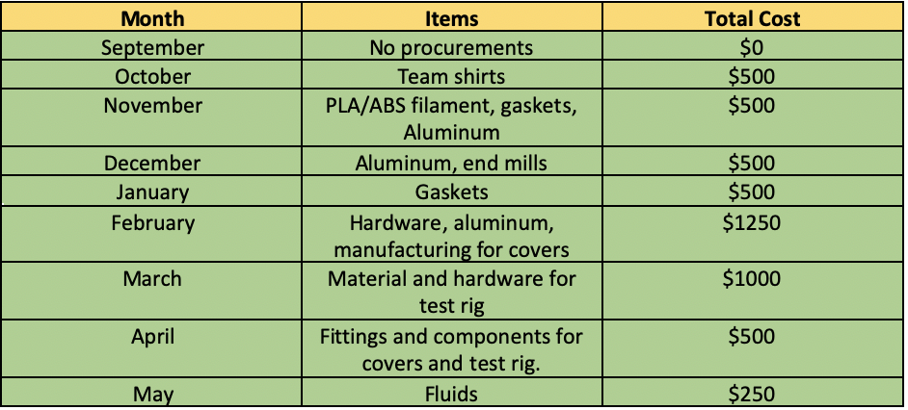
Budget - Material Budget Estimate

Slide 9
Risk Management - Project Risk List
Enough design ideas are not accumulated early on (Likelihood 2 / Consequence 4)
Incorrect engineering analysis (2 / 5)
Incorrect tolerancing (3 / 5)
Establishing material/parts needs in time (2 / 3)
Fabrication issues (3 / 4)
Prototype test rig does not adequately simulate full scale test behavior (4 / 5)
Exceeding the budget (1 / 5)

Slide 10
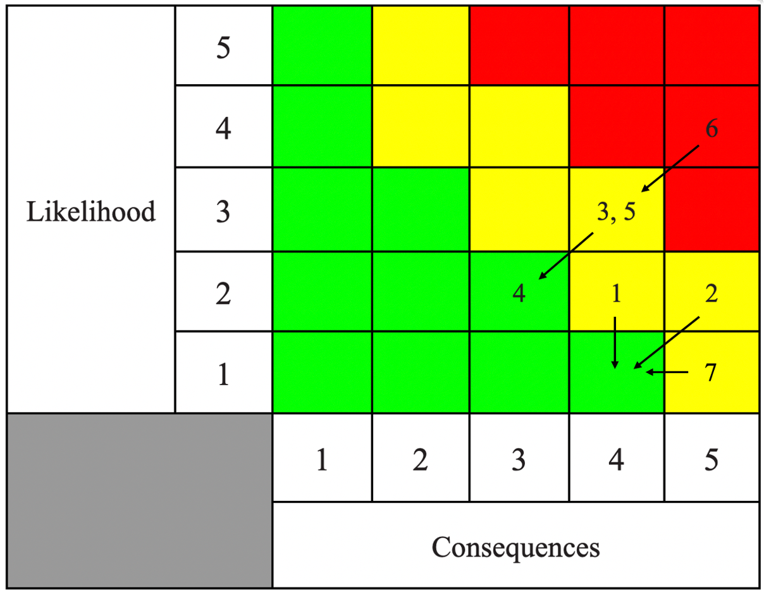
Risk Management - Project Risk Cube
Constant focus on brainstorming ideas
Verifying calculations with sponsor and professors
Verifying tolerancing with sponsors
Establishing material/parts needs early on
Learning how to use machinery early / getting help from machinists
All details will be considered and integrated into test rig
Detailed spending plan will be developed early

Slide 11
Summary / Key Points
Purpose
Design leak-proof driveshaft covers for Solar Turbines
Budget
$5000.00
Estimated Man Hours
1120 hrs
Highest Risk for Project
Prototype design rig does not adequately simulate full scale test behavior

